Slide 1
Object Oriented Design & Programming
Unit-8
Streams and Files
OODP

Slide 2
🞄 All programs we looked earlier:
🞄 input data from the keyboard.
🞄 output data to the screen.
🞄 Output would be lost as soon as we exit from the program.
🞄 How do we store data permanently?
🞄 We can use secondary storage device.
🞄 Data is packaged up on the storage device as data structures called files.
Concept of stream

Slide 3
🞄 I/O system supplies an interface to the programmer that is independent of the actual device being accessed. This interface is known as streams.
🞄 A stream is a general name given to a flow of data
🞄 A stream is a sequence of bytes
🞄 It acts either as a source from which input data can be obtained or as a destination to which output data can be sent.
Data Streams

Slide 4
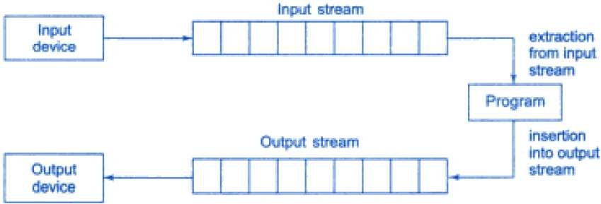
🞄 The source stream that provides data to programs is called input stream. The destination stream receives output from the program is called output stream.
🞄 Thus a program extracts the bytes from an input stream and insert bytes into an output stream.
Stream

Slide 5
🞄 So far we’ve used the cin and cout stream objects.
🞄 cin-Input stream connected to the standard input device (Usually the keyboard)
🞄 cout-Output stream connected to the standard output device (Usually the screen)
🞄 Keyboard and screen are default options.
🞄 Can redirect streams to other devices or files, if necessary.
Stream Usage

Slide 6
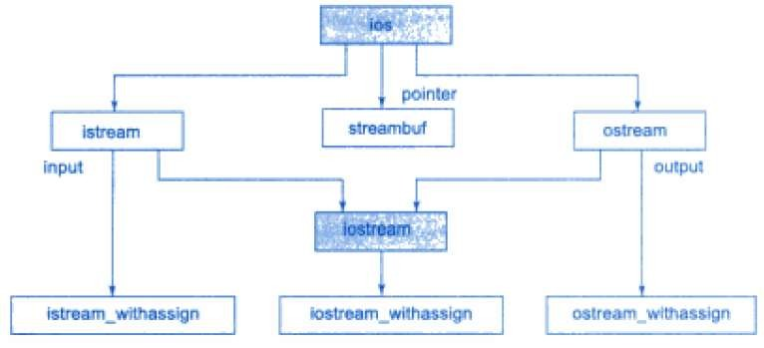
Stream classes

Slide 7
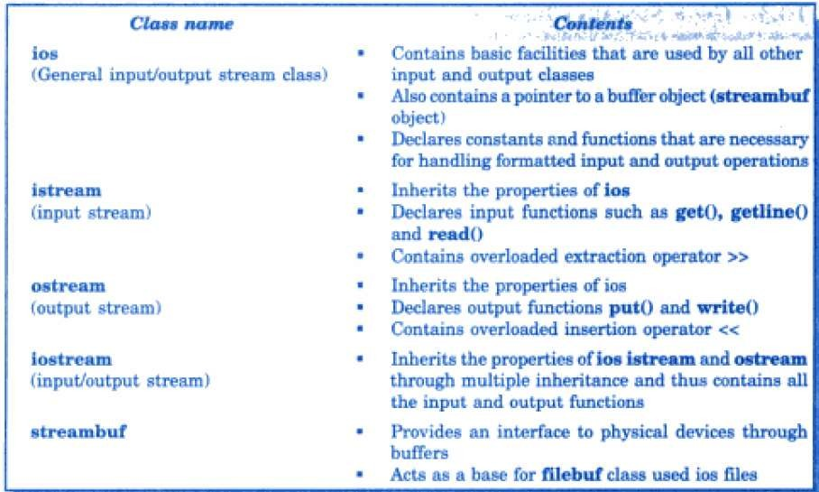
Stream classes

Slide 8
🞄 ios class provides basic support for formatted and unformatted input/output).
🞄 Also contains pointer to a buffer object (streambuf)
🞄 streambuf provides an interface to physical device through buffers.
🞄 istream and ostream class inherits properties of ios
🞄 Extraction operator >>, get(), getline() and read() are members of
istream class
🞄 Insertion operator <<, put() and write() are members of ostream
class
🞄 Iostream class inherits properties of istream, ostream class through multiple inheritance.
🞄 The class ios declared as the virtual base class so that only one copy
of its members inherited by the iostream.
🞄 istream_withassign, ostream_withassign and iostream_withassign add assignment operators to its base classes.
Stream classes

Slide 9
🞄 >> operator is overloaded in the istream class
🞄 Ex: cin>>x>>y>>z;
🞄 It reads the data character by character and assigns it to the indicated location. The reading for a variable will be terminated at the encounter of a white space or a character that does not match the destination type.
🞄 int code;
🞄 cin>>code;
🞄 Suppose the following data is given as input:
🞄 425D
🞄 >> Operator will read characters upto 5 and assign 425 to code. Character ‘D’ remains in the input stream and will be the input to the next cin statement.
Unformatted I/O Operations

Slide 10
🞄 put() and get() functions:
🞄 Two versions of get():
🞄 get(char*):Assign input character to its argument
🞄 get(void): Returns the input character
Unformatted I/O Operations
🞄 We can use both prototypes to fetch a character including the blank space, tab and the newline character.
🞄 Because these are member of input/output stream classes,
we must invoke them using appropriate object:
🞄 char c; cin.get(c) is equivalent to c= cin.get();
🞄 >> operator also used to read a character but it skip the
white spaces and newline character.
🞄 cout.put(c) used to display a character c.

Slide 11
int main()
{
int count=0; char c;
cout<<"Input Text:\n"; cin.get(c);
while(c!='\n')
{
cout.put(c); count++; cin.get(c);
}
cout<<"\nNo. of characters:"<<count<<endl;
}
Example

Slide 12
🞄 getline() and write() functions:
🞄 getline() reads a whole line of text that ends with a newline character.
cin.getline(line, size);
🞄 It will read the character input into variable line until either ‘\n’ encountered or size-1 characters are read(whichever occur first).
🞄 The newline character is read but not saved. Instead it is replace by null character.
🞄 The write function displays an entire line.
cout.write(line, size);
🞄 line represents the name of the string to be displayed and size
indicates the number of characters to display.
🞄 Note that If the size is greater than the length of line, then it displays beyond the bounds of line.
Unformatted I/O Operations

Slide 13
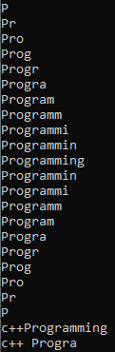
int main()
{
char *s1="c++";
char *s2="Programming"; int m=strlen(s1);
int n=strlen(s2);
for(int i=1;i<n;i++)
{
cout.write(s2,i); cout<<"\n";
}
for(int i=n;i>0;i--)
{
cout.write(s2,i); cout<<"\n";
}
//concatinating strings cout.write(s1,m).write(s2,n); cout<<"\n";
Example
cout.write(s1,10);
}

Slide 14
Formatted I/O Operations
🞄 C++ supports a number of features that could be used for formatting the output. These features include:
ios class functions and flags
Manipulators
User defined output functions

Slide 15
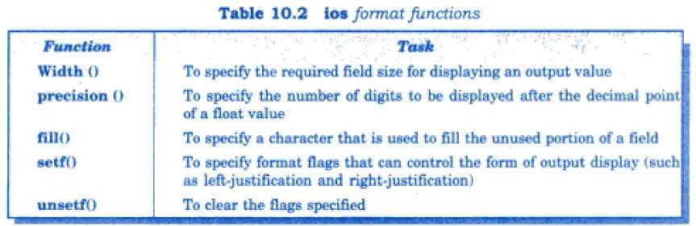
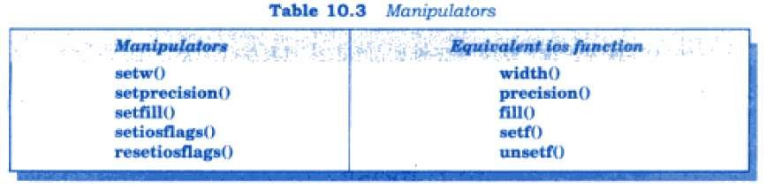
Formatted I/O Operations

Slide 16
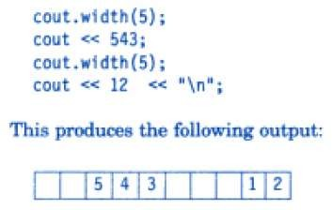
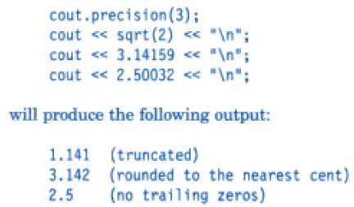
🞄 Width:
ios format functions
🞄 precision( ):

Slide 17
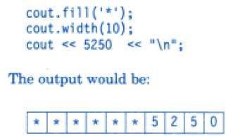
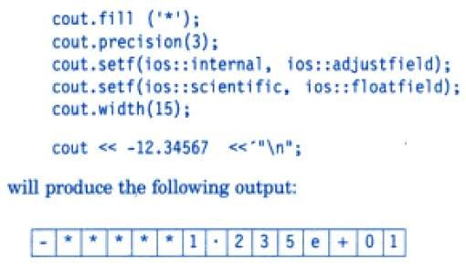
🞄 fill( ) :
ios format functions
🞄 setf( ) :

Slide 18
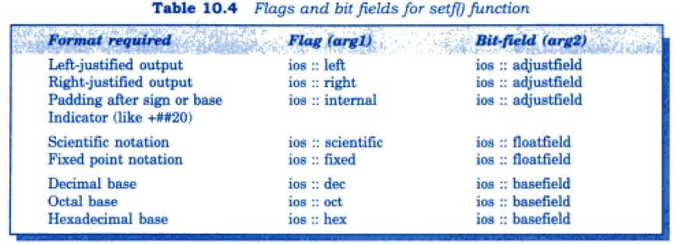
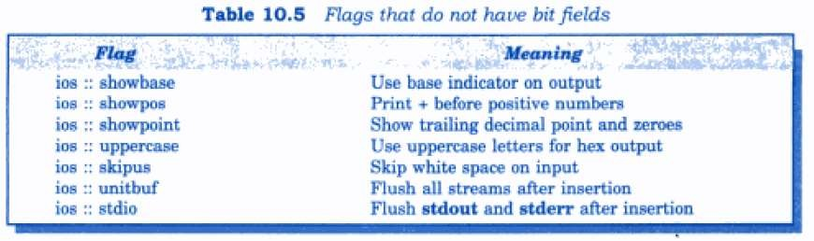
ios format functions

Slide 19

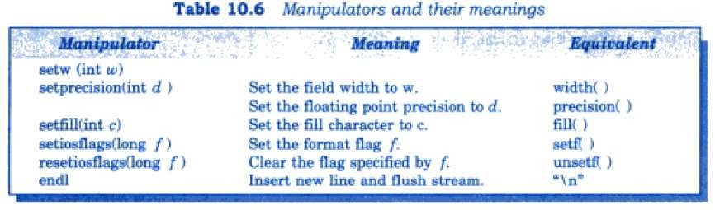
🞄 The header file iomanip provides a set of functions called manipulators, to manipulate the output formats
🞄 Some manipulators are more convenient to use. For example, two or more manipulators can be used as a chain in one statement.
Managing output with Manipulators

Slide 20


🞄 Examples:
Managing output with Manipulators
🞄 We can jointly use the manipulators and ios function s in a program

Slide 21
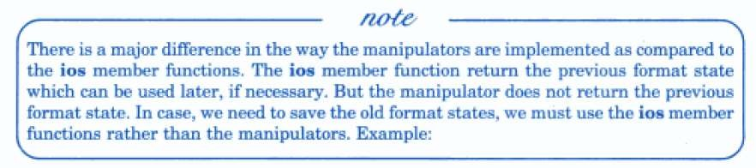
cout.precision(2);
int p = cout.precision(4);
// previous state
// current state
🞄 When these statements are executed, p will hold the value of 2
(previous state) and the new format state will be 4.
🞄 We can restore the previous format state as follows:
cout.precision(p); // p = 2
Difference b/w manipulators and ios member function
🞄 We can create our own manipulators also.
🞄 User defined manipulators

Slide 22
🞄 A file is a collection of related data stored in a particular area on the disk.
🞄 Programs can be designed to perform read and write operations on these files.
🞄 2 kind of communication:
🞄 Data Transfer between console unit and the program
🞄 Data Transfer between the program and a disk file
File Handling

Slide 23
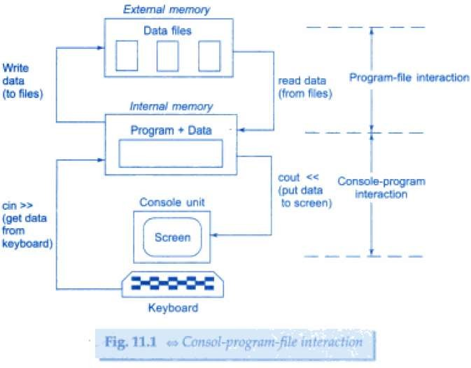
Console- Program-File interaction

Slide 24
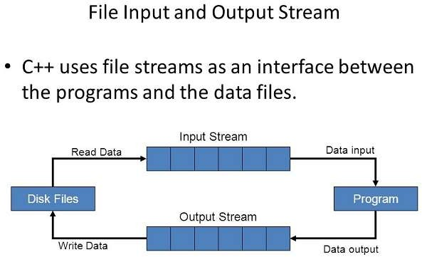
File Input Output Stream

Slide 25
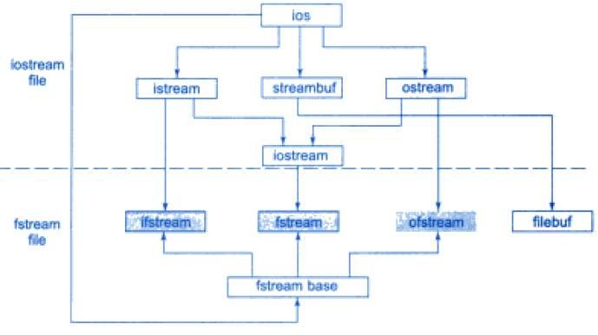
Classes for File Stream operations

Slide 26
🞄 Classes that define file handling methods/functions:
ifstream
ofstream
fstream
Classes for File Stream operations
🞄 These 3 classes are derived from fstreambase and corresponding iostream.
🞄 Header file fstream contain these 3 classes

Slide 27
2. Data type and structure
1. Suitable name for the file
Purpose
Opening method
Classes for File Stream operations

Slide 28
🞄 A file can be opened in 2 ways:
🞄 1. Using Constructor function of a class
🞄 2. Using the member function open( ) of the class
🞄 1st method is useful when we use only one file in the stream
🞄 2nd method is used when we want to manage multiple files using one stream.
Opening and closing file

Slide 29
🞄 Constructor is used to initialized an object while it is being created Here, a filename is used to initialize the file stream object. This involves the following steps:
Create a file stream object to manage the stream using the appropriate class Like, class ofstream is used to create output stream and the class ifstream to create the input stream.
Initialize the file object with the desired filename.
Opening file using constructor
🞄 Example,
ofstream outfile (“results”);
ifstream infile (“data”);
// output only
// input only

Slide 30
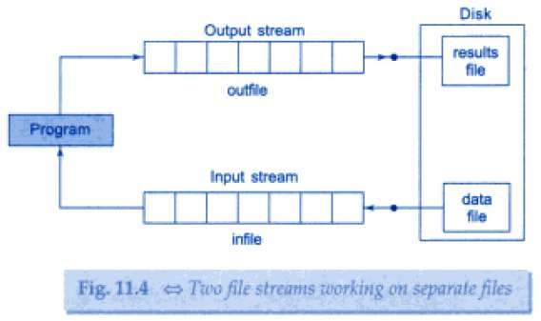
Opening file using constructor
🞄 When a file is, opened for writing only, a new file is created
if there is no file of that name.
🞄 If a file with same name already exists, then its contents are deleted and the file is, presented as a clean file.

Slide 31
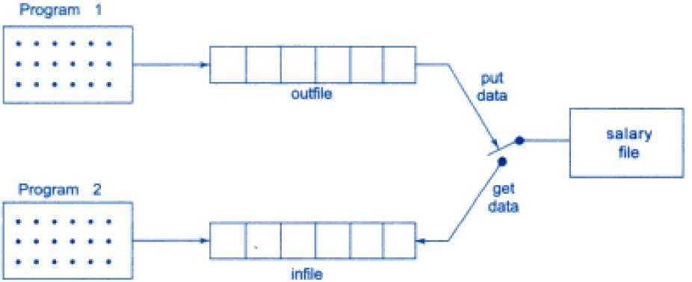
🞄 ofstream outfile(“salary”); // create outfile and connects “salary” to it.
🞄 ifstream infile(“salary”); // create infile and connects “salary” to it.
🞄 These statements can be in same program or different program.
🞄 connection with a file is closed automatically when stream object
expires.
🞄 Or we can use outfile.close() / infile.close() to disconnect outfile / infile stream from “salary” file.
Two file stream working on one file

Slide 32

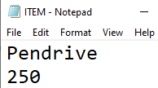
Opening file using constructor
#include<iostream> #include<fstream> using namespace std; int main() { char name[30]; float cost; ofstream outf("ITEM"); cout<<"Enter Item name:"; cin>>name; outf<<name<<"\n"; cout<<"Enter Item cost:"; cin>>cost; outf<<cost<<"\n"; outf.close(); | ifstream inf("ITEM"); inf>>name; inf>>cost; cout<<"\n"; cout<<"Item Name:"<<name<<"\n"; cout<<"Item Cost:"<<cost<<"\n"; inf.close(); }

Slide 33

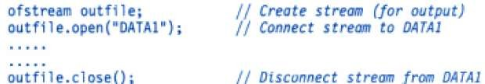
same stream object.
🞄 The function open()can be used to open multiple files that use the
🞄 For example, we may want to process a set of files sequentially. In such cases, we may create a single stream object and use it to open each file in turn.
🞄 But at a time only one file is connected to the stream. For that,
close the first and then open the second.
Opening File using open( )

Slide 34
🞄 while(fin)
🞄 Detection of the end of file condition is required while reading data
🞄 Here, fin is object of ifstream
🞄 While loop terminates when fin returns a value of Zero on reaching end of file condition.
🞄 Another approach to detect eof()
🞄 If(fin.eof( )!=0) { exit(1); }
🞄 eof( ) is member function of ios class,
🞄 It returns a non-zero value, if EOF condition is encountered,
and zero otherwise.
Detecting End of the file

Slide 35
Opening File using open( )
#include<iostream> #include<fstream> using namespace std; int main() { ofstream fout; fout.open("country"); fout<<"United States of America\n"; fout<<"United Kingdom\n"; fout<<"South Korea\n"; fout.close(); fout.open("capital"); fout<<"Washington\n"; fout<<"London\n"; fout<<"Seoul\n"; fout.close(); //Reading the files const int N=80; char line[N]; | ifstream fin; fin.open("country"); cout<<"Contents of country file: \n"; while(fin) { fin.getline(line, N); cout<<line<<endl; } fin.close(); fin.open("capital"); cout<<"Contents of capital file: \n"; while(fin) { fin.getline(line, N); cout<<line<<endl; } fin.close(); return 0; }

Slide 36
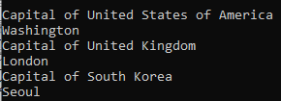
Reading from 2 files simultaneously
#include<iostream> #include<fstream> #include<stdlib.h> using namespace std; int main() { const int SIZE=80; char line[SIZE]; ifstream fin1,fin2; fin1.open("country"); fin2.open("capital"); for(int i=1; i<=3;i++) { if(fin1.eof()!=0) { cout<<"\nExit from country \n"; exit(1); } | fin1.getline(line,SIZE); cout<<"\nCapital of "<<line<<"\n"; if(fin2.eof()!=0) { cout<<"\nExit from capital \n"; exit(1); } fin2.getline(line,SIZE); cout<<line<"\n"; } }

Slide 37
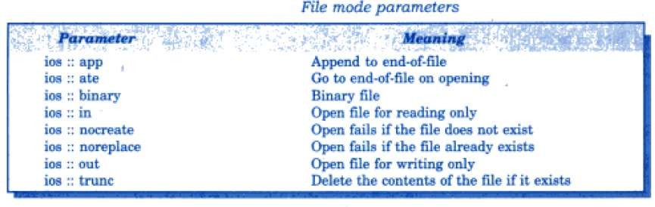
🞄 We have used one argument, but these functions can take 2
🞄 We have used ifstream and ofstream constructors and the function open( ) to create new files as well as to open existing files.
arguments.
Stream-object . open(“file name”, mode);
Open file Modes
🞄 Second argument specifies the purpose for which file is opened.

Slide 38
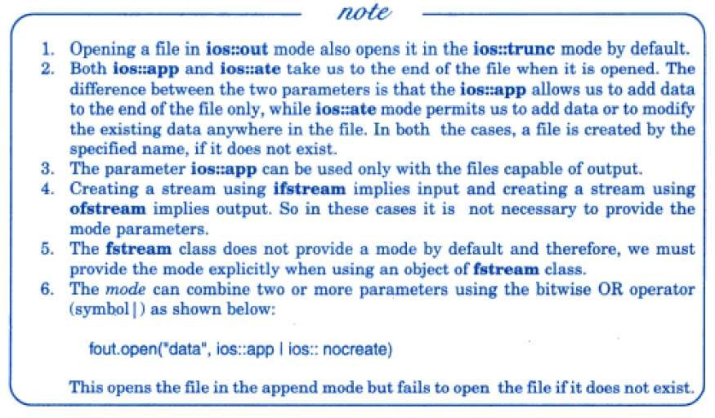
Open file Modes

Slide 39
🞄 Each file has 2 associated pointers known as file pointers.
🞄 1. Input Pointer
🞄 2. Output Pointer
🞄 Input pointer is for reading the contents and output pointer is for writing the contents.
🞄 Each time an input or output operation takes place, the
appropriate pointer is automatically advanced.
🞄 File modes:
🞄 Read only mode ->Input pointer at beginning
🞄 Write only mode ->Existing content deleted and
Output pointer at beginning
🞄 Append mode ->Output pointer at end of file
File Pointers & their Manipulators

Slide 40
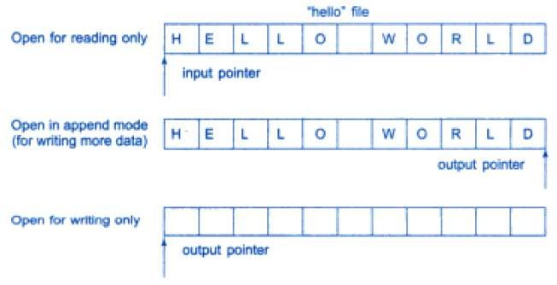
File Pointers & their Manipulators

Slide 41
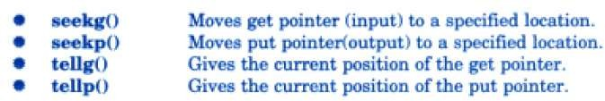
inside the file?
🞄 How can we move the file pointer to any desired position
🞄 The file stream classes support the following functions to manage this.
🞄 For ex.
infile.seekg(10);
🞄 It moves the file pointer to Byte number 10.
🞄 Byte begins from zero number, so pointer will pointing to 11th byte in file.
Functions for manipulation of file pointers

Slide 42
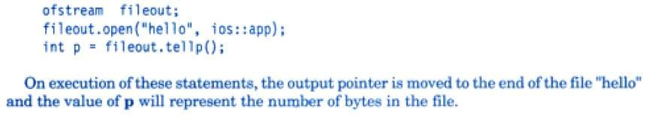
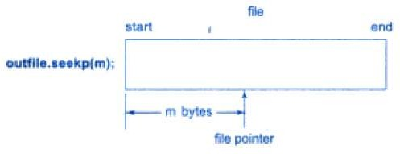
Functions for manipulation of file pointers
🞄 Specifying the offset:
🞄 How to move file pointer to a desired location using
seek function

Slide 43
🞄 seekg( ) and seekp( ) can also be used with 2 arguments
🞄 seekg(offset, refposition);
🞄 Seekp(offset, refposition);
🞄 Parameter offset represents number of bytes the file pointer is to be moved from the location specified by parameter refposition.
🞄 Refposition takes one of the following:
🞄 ios :: beg →Start of file
Functions for manipulation of file pointers
🞄 ios :: cur
🞄 ios ::end
→Current position of the pointer
→End of the file

Slide 44
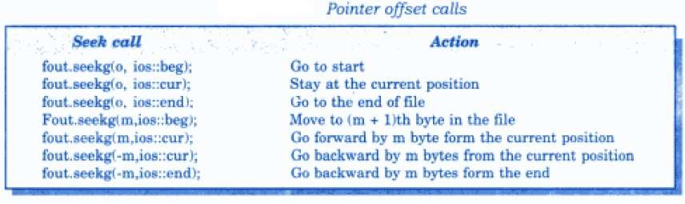
Functions for manipulation of file pointers

Slide 45
🞄 Pair of functions, put( ) and get( ) are designed for handling a
single character at a time.
🞄 Pair of functions, write( ) and read( ) are designed to write and read blocks of binary data.
Sequential Input Output Operations
#include<iostream> #include<fstream> #include<string> int main( ) { char string[80]; cout<<“Enter a String”; cin>>string; int len=strlen(string); fstream file; file.open(“Text”,ios::in | ios::out); | for(int i=0;i<len;i++) file.put(string[i]); file.seekg(0); char ch; while(file) { file.get(ch); cout<<ch; } return 0; }

Slide 46
Sequential Input Output Operations
🞄 We have used an fstream object to open the file. fstream object can handle both input and output.
🞄 File opened in ios::in and ios::out mode.
🞄 After writing the file, we want to read entire file and display contents. But file pointer has already moved to the end of file, so we must bring it back to start of file.
🞄 This is done by statement
🞄 file.seekg(0);

Slide 47
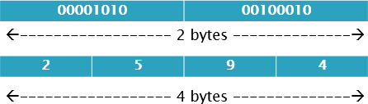
🞄 Binary Files:
🞄 Write( ) and Read( ) Functions:
🞄 The functions write( ) and read( ), handle the data in binary form.
🞄 This means that the values are stored in the disk file, same format as they are stored in the internal memory.
🞄 How an int value 2594 is stored in binary and character format? An int takes 2 bytes to store its value in binary form, but 4 digit int will take 4 bytes to store in character form.
Sequential Input Output Operations

Slide 48
🞄 Binary format is more accurate for storing the numbers
infile.read( (char *) &V, sizeof(V) ); outfile.write( (char *) &V, sizeof(V) );
Sequential Input Output Operations
🞄 These function take two arguments. The first is the address of the variable V and the second is the length of that variable in bytes.
🞄 The address of variable must be cast to type char * (i.e. pointer to character type).

Slide 49


int main()
{
float height[4]={175.5, 153.0, 167.25, 160.70};
ofstream outfile;
outfile.open("BINARY");
outfile.write((char *) &height, sizeof(height)); outfile.close();
for(int i=0;i<4;i++) height[i]=0;
Binary file Example
ifstream infile; infile.open("BINARY");
infile.read((char *) &height,sizeof(height)); for(int i=0;i<4;i++)
{
cout.setf(ios::showpoint); cout.setf(ios::fixed, ios::floatfield); cout<<setw(10)<<setprecision(2)<<height[i];
}
infile.close();
}

Slide 50
Reading and Writing class Object
🞄 Binary input and output functions read() and write() are designed to do exactly this job.
🞄 They handle entire structure of object as a single unit.
🞄 They only read and write the data members not member
function.
🞄 Length of the object is obtained using sizeof operator. This length represents the sum of length of all the data members of the object.

Slide 51
Reading and Writing class Object
class INVENTORY { char name[10]; int code; float cost; public: void readdata(); void writedata(); }; void INVENTORY :: readdata() { cout<<"Enter Name:"; cin>>name; cout<<"Enter Code:"; cin>>code; cout<<"Enter Cost:"; cin>>cost; } void INVENTORY :: writedata() { cout<<setw(10)<<name; cout<<setw(10)<<code; cout<<setw(10)<<cost<<endl; } | int main() { INVENTORY item[3]; fstream file; file.open("STOCK.dat",ios::in | ios::out); cout<<"Enter the details of 3 items \n"; for(int i=0;i<3;i++) { item[i].readdata(); file.write((char *) &item[i],sizeof(item[i])); } file.seekg(0); cout<<"\nOUTPUT\n\n"; for(int i=0;i<3;i++) { file.read((char *) &item[i],sizeof(item[i])); item[i].writedata(); } file.close(); }

Slide 52
🞄 Updating is a routine task in the maintenance of any data file. The updating would include one or more of the following tasks:
🞄 Displaying the contents of a file.
🞄 Modifying an existing item.
🞄 Adding a new item.
🞄 Deleting an existing item.
Updating a File: Random Access
🞄 These actions require the file pointers to move to a particular location that corresponds to the item/object under consideration.
🞄 Example: Phone Book add, modify, delete, search, display.

Slide 53
🞄 Updates can be easily implemented if the file contains a collection of items/objects of equal lengths.
🞄 Find size of the object:
int object_length=sizeof(object);
🞄 Location of m^{th} object:
int location=m * object_length;
🞄 Location gives the byte no. of the first byte of m^{th} object.
🞄 Then seekg() or seekp() can be used to set the file pointer to reach this byte.
🞄 Find total number of objects in a file:
int n = file_size/object_length;
🞄 file_size can be obtained using tellg() or tellp() when file pointer is located at the end of file.
Updating a File: Random Access

Slide 54
🞄 Some of possible errors during file handling are given below:
Attempting to open a non-existent file in read mode.
The file name used for a new file may already exist.
Attempting to read beyond the end of file.
Sufficient disk space is not available while writing to a file.
Using a invalid file name.
Attempting to perform an operation when the file is not opened for that purpose.
Error Handling during File Operations
🞄 C++ file stream inherits a ‘stream-state’ member from the class ios. This member records information on the status of a file that is being currently used.
🞄 ‘stream-state’ uses bit fields to store the status of the error conditions.

Slide 55
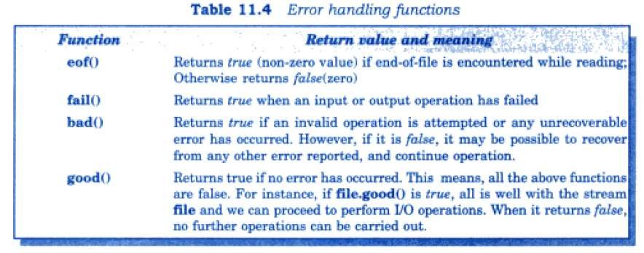
Error Handling during File Operations

Slide 56
Thank you

